Slide 1
RING
SIGNATURES
-by Shivam Agarwal
CSE 2020123

Slide 2
INTRODUCTION
Ring signatures were first introduced in 2001 by Rivest, Shamir and Tauman in 2001 based on group signatures introduced in 1991.
They allow users to sign messages as a group rather than as an individual.
Allow users to remain anonymous as a member of the group thus giving you some credibility.
No one can deanonymize you like in Group Signatures scheme.
Can be generated arbitrarily by anyone using the public keys of the other group members without their knowledge.
Eg - Allows a whistleblower to reveal confidential information anonymously while still having some credibility.

Slide 3
IMPLEMENTATION
Assumptions : that every user has a valid public key(RSA in this case) and that all the members of the group are honest members.
Inputs : all the public keys, message m, user who is signing the message
Choose a key: compute a symmetric key k as the hash of the message i.e k=H(m)
Pick a random 'glue' value : The signer picks a value v uniformly at random from {0, 1}^{b}
Pick random X_{i}'s : The signer picks random X_{i} for all the other members of the group uniformly and independently from {0, 1}^{b}.

Slide 4
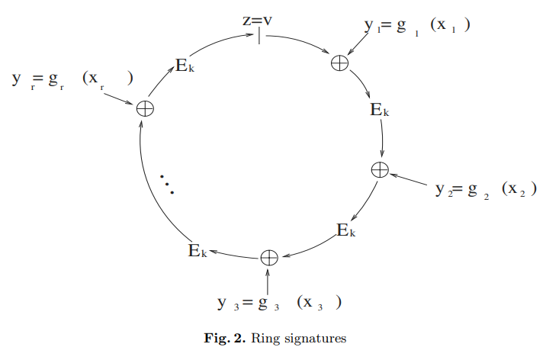

Slide 5
IMPLEMENTATION
Compute Y_{i}'s : Compute Y_{i}'s for all the X_{i}'s other than that of the signer using the function g, where Y_{i} = g_{i}(X_{i}).
Get Y_{s} : Use the combining function(C_{k,v}(Y₁, Y₂,..., Y_{r})) and equate to v, this gives us a unique value for Y_{s}.
Get X_{s} : Compute X_{s} = g_{s}⁻¹(Y_{s}).
Output Signature : (P₁, P₂,…, P_{r}; v; X₁, X₂,…, X_{r})

Slide 6
PRACTICAL APPLICATIONS
Ring Signatures can be used to E-Voting, Secret Ballot, revealing information anonymously, etc.
LIMITATIONS
Can be inefficient for a large group of people.
As there is no one who can deanonymize the signer, so the signer might use this for nefarious purposes.
No security guarantee is given if there is a malicious member in the group, or some public keys are generated with malicious intent.
Source - “How to Leak a Secret” by Ronald L. Rivest, Adi Shamir, and Yael Tauman

